Slide 1
What’s New in Visual Studio 2017
Umamaheswaran Manivannan
Senior Software Engineer
@UMW1990

Slide 2
Performance improvements
A new setup experience
Start Visual Studio faster
Decrease solution load time
Faster on-demand loading of extensions

Slide 3
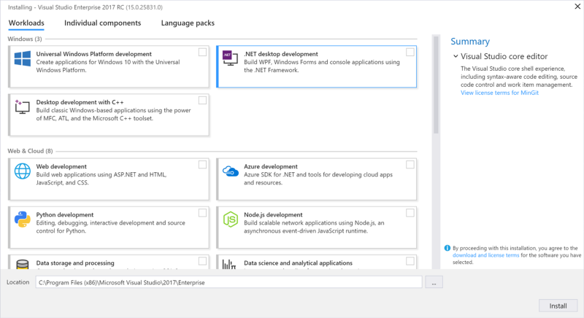
Faster installation - Install workloads

Slide 4
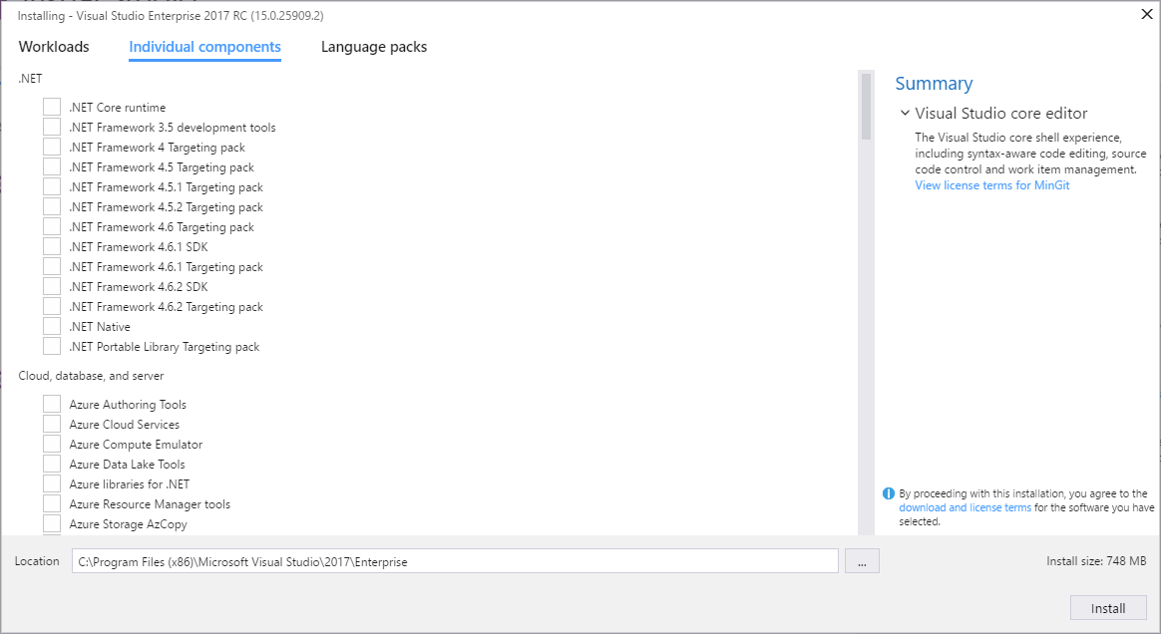
Install individual components

Slide 5
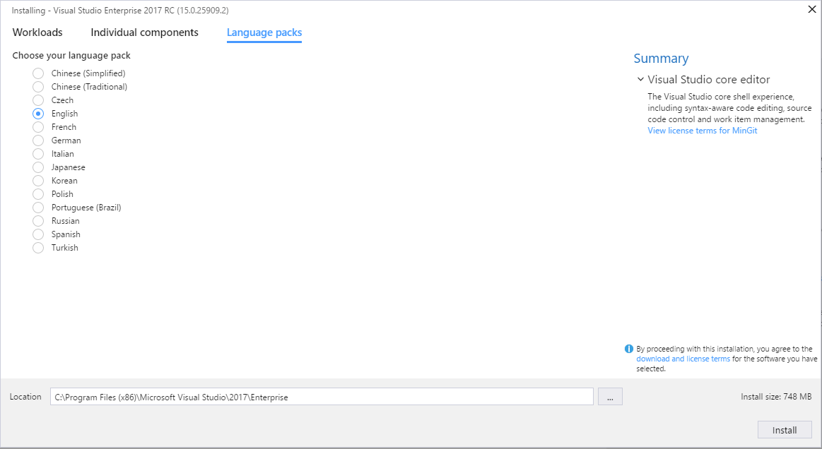
Install language packs

Slide 6
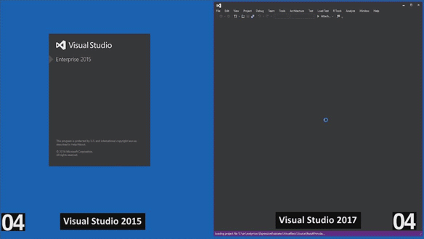
Visual Studio 2017 is up to 4x Faster than Visual Studio 2015

Slide 7
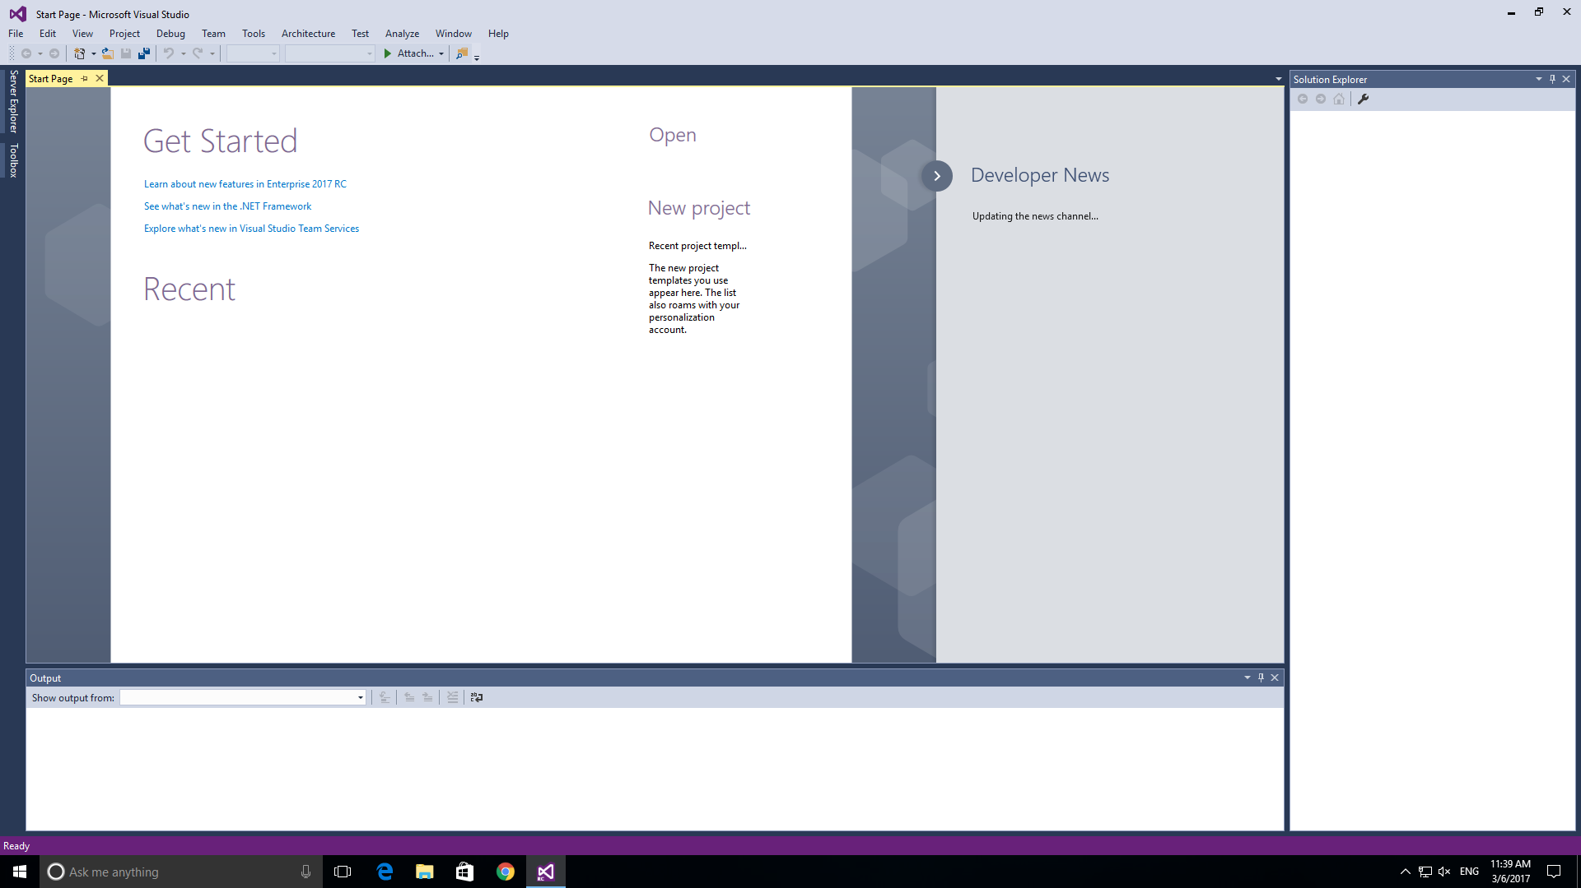
Start Visual Studio faster

Slide 8
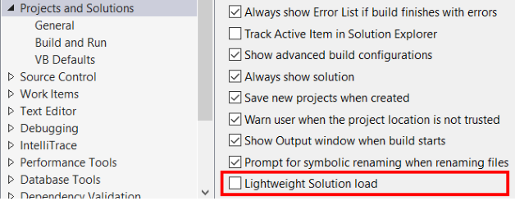
Decrease solution load time

Slide 9
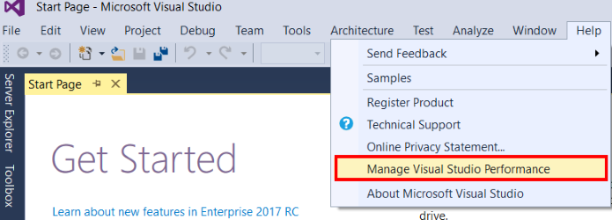
Faster on-demand loading of extensions

Slide 10
Thank you!!

